Slide 1

Analyzing Operational Challenges at Tesla Motors

Slide 2

1. Sales Performance Analysis 1. Which vehicle model has the highest sales volume?
Input
OUTPUT
select top 1 v.vehicleid , v.model , sum(o.totalamount) as highest_sales_volume
from orders o
join vehicles v on o.vehicleid = v.vehicleid
group by v.vehicleid , v.model
order by highest_sales_volume desc

Slide 3
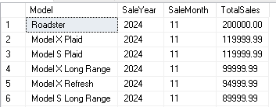
1. Sales Performance Analysis 2. Are there any seasonal trends in vehicle sales?
Input
OUTPUT
SELECT
v.Model,YEAR(o.OrderDate) AS SaleYear, MONTH(o.OrderDate) AS SaleMonth, SUM(o.TotalAmount) AS TotalSales
FROM Orders o
JOIN Vehicles v ON o.VehicleID = v.VehicleID
GROUP BY
YEAR(o.OrderDate), MONTH(o.OrderDate), v.Model
ORDER BY SaleYear, SaleMonth, TotalSales DESC;

Slide 4
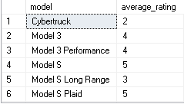
2 . Customer Feedback Insights 1. What is the average rating for each vehicle model?
Input
OUTPUT
select model , avg(rating) as average_rating
from vehicles v
join CustomerFeedback cf on v.vehicleid = cf.vehicleid
group by model

Slide 5
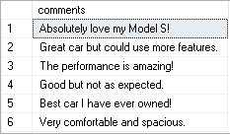
2 . Customer Feedback Insights 2 . Are there any common themes in customer comments?
Input
OUTPUT
select comments
from CustomerFeedback

Slide 6

2 . Customer Feedback Insights 3 . How many customers have provided feedback on their vehicles?
Input
OUTPUT
select count(*) as number_of_customers
from CustomerFeedback

Slide 7
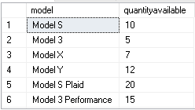
3 . Inventory Management 1 . What is the current inventory level for each vehicle model?
Input
OUTPUT
select v.model , i.quantityavailable
from vehicles v
join inventory i on v.vehicleid = i.vehicleid

Slide 8
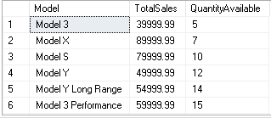
3 . Inventory Management 2 . How does inventory correlate with sales data over the past year?
Input
OUTPUT
SELECT v.Model, SUM(o.TotalAmount) AS TotalSales,i.QuantityAvailable
FROM Orders o
JOIN Vehicles v ON o.VehicleID = v.VehicleID
JOIN Inventory i ON v.VehicleID = i.VehicleID
WHERE o.OrderDate >= DATEADD(YEAR, -1, GETDATE()) -- Sales in the last year
GROUP BY v.Model, i.QuantityAvailable;

Slide 9
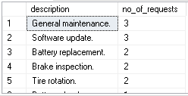
4. Service Record Analysis 1 . What are the most common types of service requests?
Input
OUTPUT
select description , count(serviceid) as no_of_requests
from ServiceRecords
group by description
order by no_of_requests desc

Slide 10
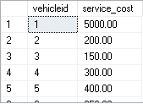
4. Service Record Analysis 2 . Which vehicle models have the highest service costs?
Input
OUTPUT
select vehicleid , sum(cost) as service_cost
from ServiceRecords
group by vehicleid

Slide 11
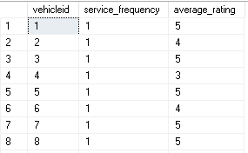
4. Service Record Analysis 3 . Is there a correlation between service frequency and customer satisfaction ratings?
Input
OUTPUT
select v.vehicleid , count(sr.serviceid) as service_frequency ,
avg(cf.rating) as average_rating
from vehicles v
left join ServiceRecords sr ON v.VehicleID = sr.VehicleID
left join CustomerFeedback cf ON v.VehicleID = cf.VehicleID
group by v.vehicleid

